Slide 1
Project 4
Data visualization
Clément Pilastre & Damian Borsiak

Slide 2

Subject:Airbnb

Slide 3
Plan:Where to start?
Preparation
Data Cleaning
Visualisation
Presentation
Excel + Trello
Python / Jupiter
Matplotlib + Seaborn
Google Slides

Slide 4
Challenges:Troubles along the way
Navigation
Between:
Matplotlib complexity and Seaborn simplicity
Transformation
Not always easy to find data for the right chart
Efficiency
Resolution of 1 problem highlighted existence of 2 new one
File size
Complicated Visualisation
due to large dataset
Hardware Capacity
Google Collab to the rescue!

Slide 5
Libraries:What did the magic?
wordcloud
seaborn
Libraries
squarify
pandas
matplotlib
numpy
LabelEncoder from sklearn

Slide 6
Data:Statistics
102,599 rows
Before cleaning
26 columns
Before cleaning
98,589 rows
After cleaning
22 columns
After cleaning
4,010 / 4
Rows/Columns Dropped

Slide 7

Cleaning:How was it done?
1
2
Blanks
Numeric Data Type
Large number of Blanks in various columns - partially replaced, partially dropped
Numeric columns that instead of Integers were set up as Strings
Error cells
Mean of numbers
Large number of incorrect or mistyped data
Some columns required to be filled with average value
3
4

Slide 8
Learnings:What do we know?
NAMES
Names of hosts represents locations and qualities
RULES
Smoking is the most important for the owners
FEES
Hosts pay around 20 % of service fees to AirBnb
RATING
Hard to understand why data are showing as integers not floats with partial scores ie: 4.56
UNIQUE HOST
House owners with multiple properties / Agencies

Slide 9
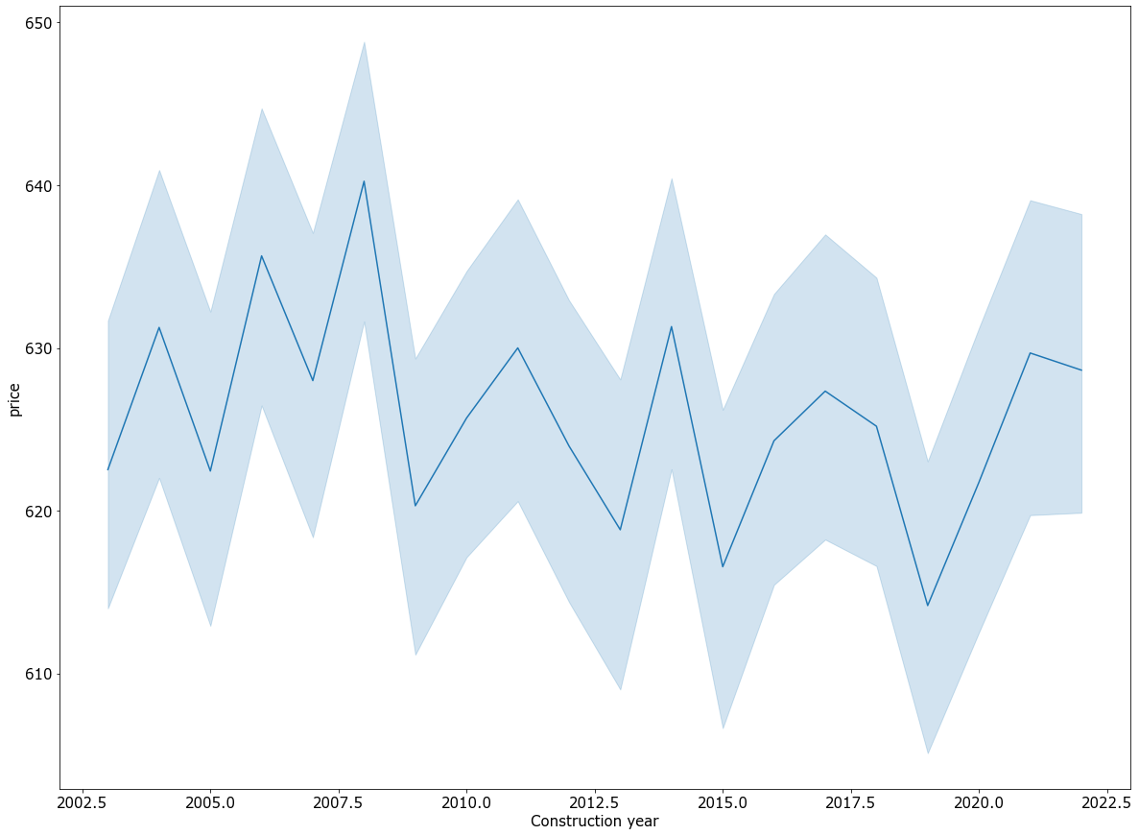

Charts:Linear
Average renting price relative to construction year
Charm of older buildings might be influencing the price

Slide 10
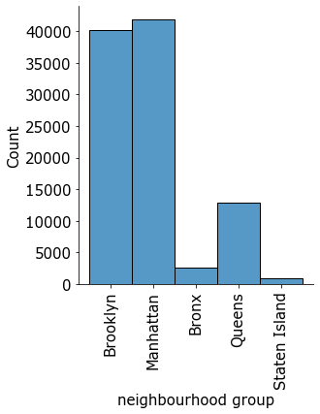
Charts:Bar
Number of listings by NYC boroughs
Overwhelming majority in Brooklyn and Manhattan clearly

Slide 11
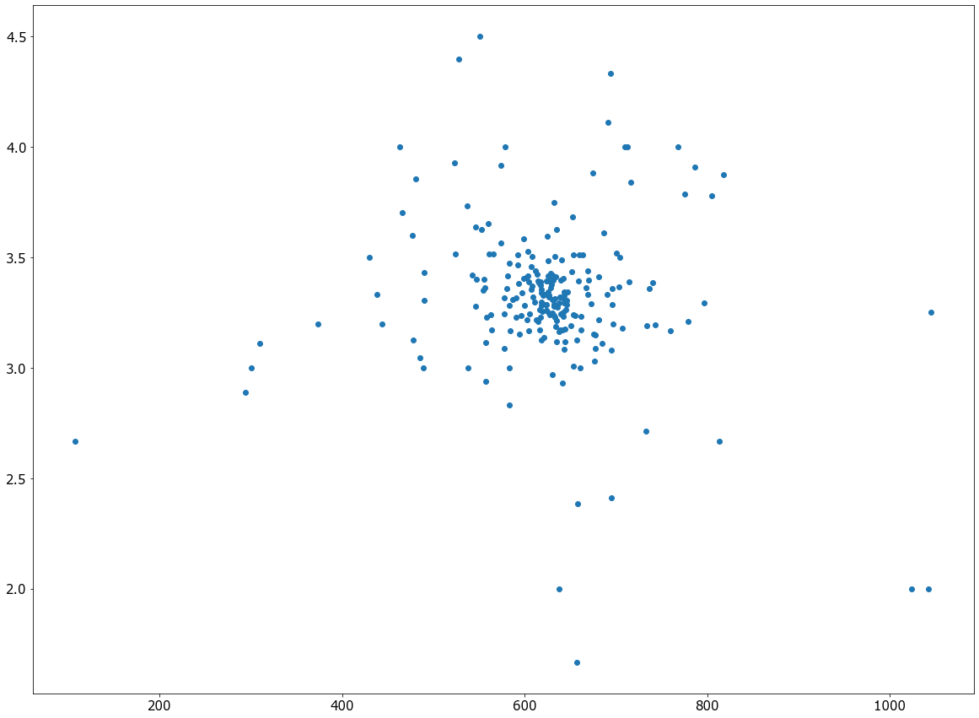
Charts:Scatter
Neighbourhood average rating over average price
Concentration of ratings around 3.3 starts and 620 USD

Slide 12
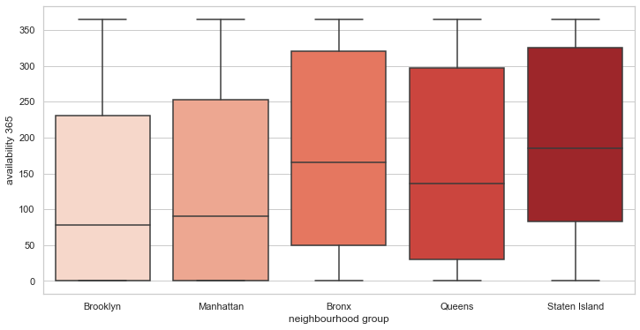
Charts:Boxplot
Repartition of year-long availability per NYC boroughs
Bottom heavy results in Brooklyn and Manhattan
Influenced by number of listings ??

Slide 13
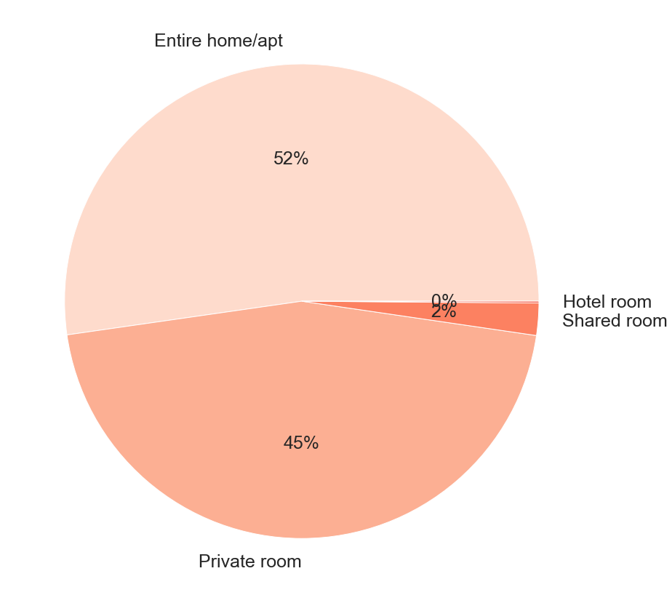
Charts:Pie
Type of Properties
Majority of rentals are:
Private rooms
Entire homes/apartments

Slide 14



Charts:Radar

Slide 15
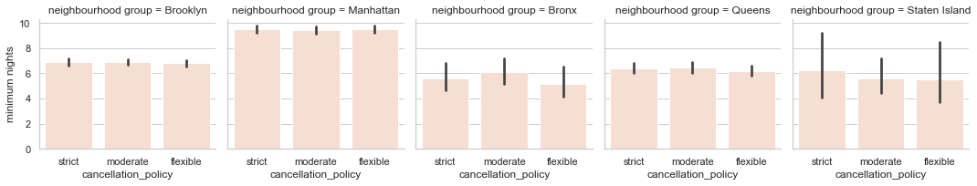
Charts:Multiple Series
Minimum nights per cancellation policy for each Boroughs

Slide 16
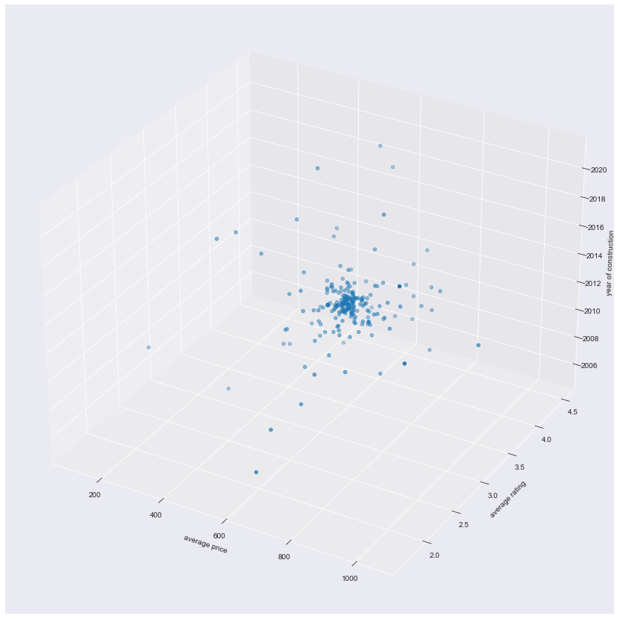
Charts:3D
Average price versus average rating over the construction year by neighborhood
Used the previous scatter plot as a basis and added a time dimension with the construction year

Slide 17
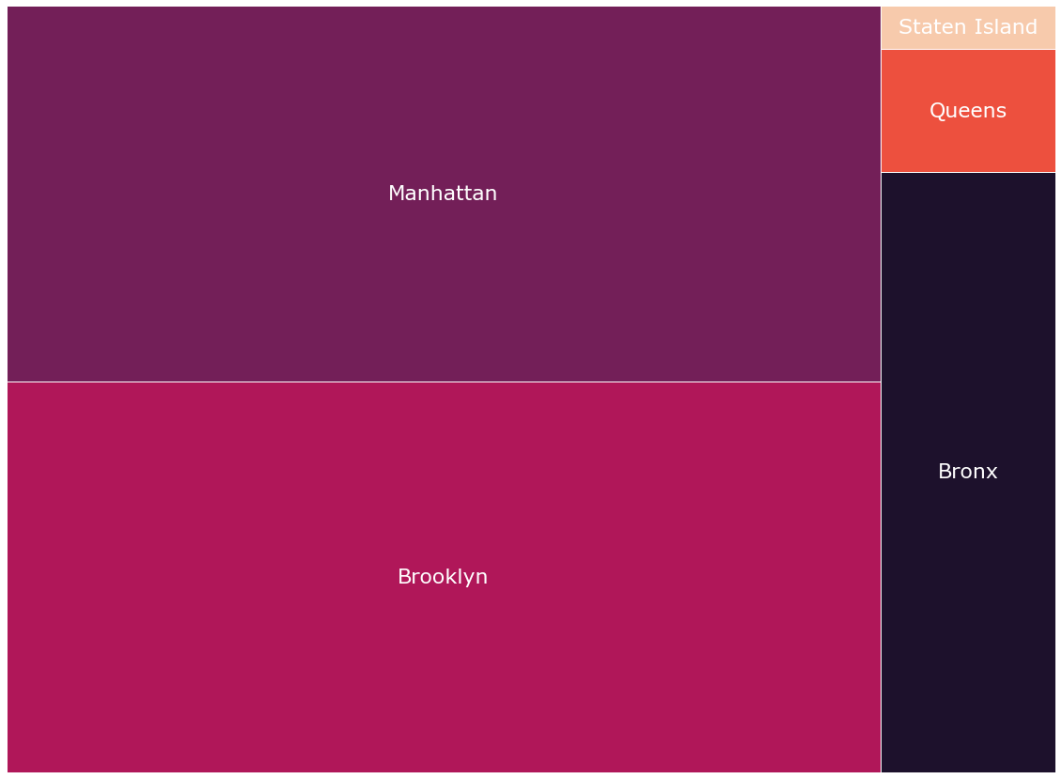
Bonus:Treemap
Repartition of total number of offers by boroughs
Another - maybe more appealing - way to represent repartition between boroughs, other than our previous bar chart

Slide 18
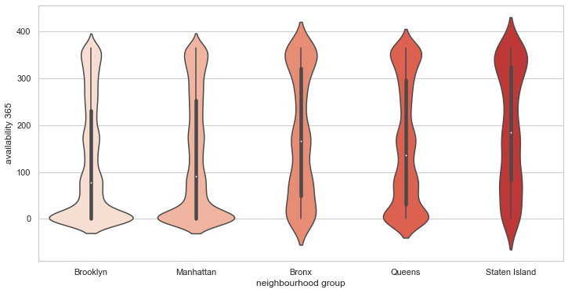
Bonus:Violin
Repartition of year-long availability by NYC boroughs

Slide 19
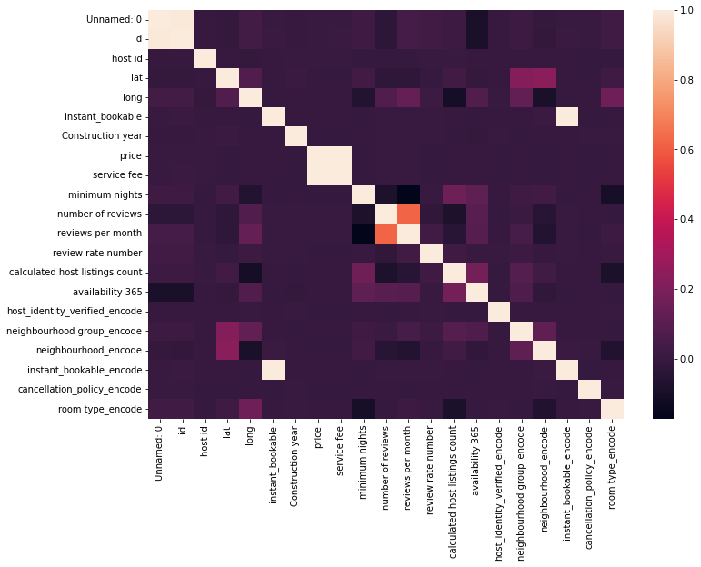
Bonus:Corr matrix
Repartition of total number of offers by boroughs
Very limited correlation even after encoding text columns

Slide 20

Bonus:Wordcloud - Names column
Two distinct clusters : One about location and one with adjectives about the room

Slide 21

Bonus:Wordcloud - Rules column
The biggest worry from hosts seems to be about smoking or pets

Slide 22
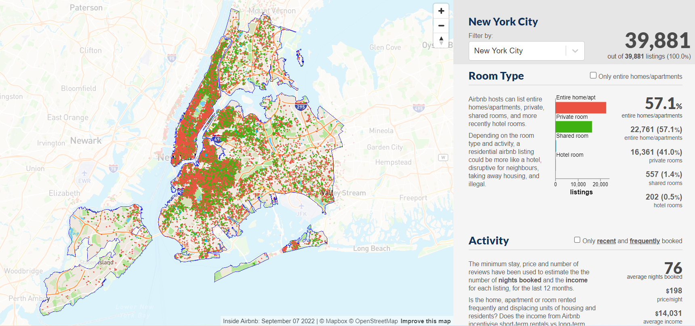
Bonus:AirBnB website

Slide 23


